Slide 1
Welcome to Skycademy

Slide 2
Important Questions
Where are the toilets?
Will there be more tea?
What are the timings for the day(s)?
What should I know already?
Do I need to have used a Raspberry Pi before?
Kit

Slide 3
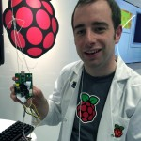
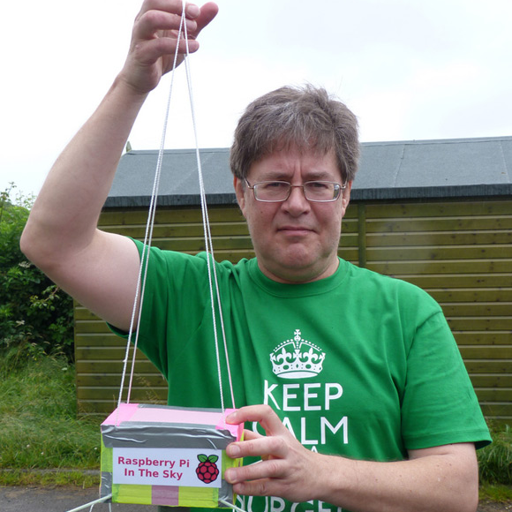

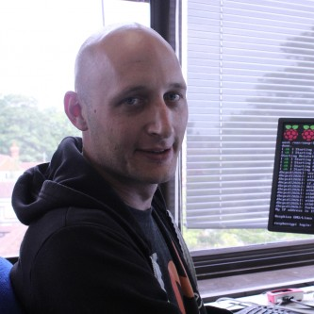

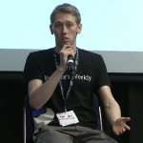
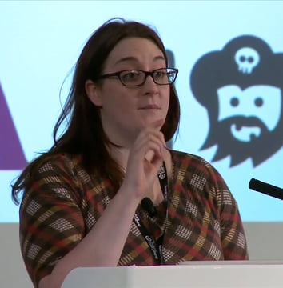
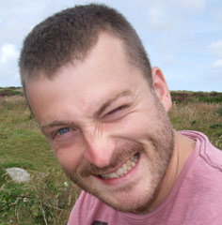
The team
James Robinson
Dave Akerman
Carrie Anne Philbin
Marc Scott
Clive Beale
Ben Nuttall
Rachel Rayns
Dave Honess

Slide 4


Slide 5
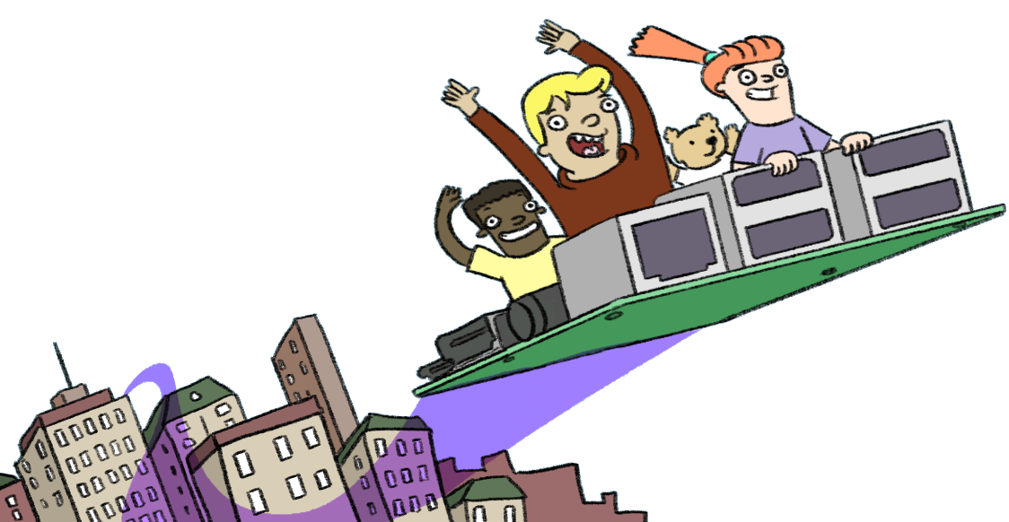
Aims
Demonstrate High Altitude Ballooning as an exciting, challenging and inexpensive activity which young people should be able to experience
To gives teachers valuable hands on experience of what a launch involves, to build, launch, track and recover a payload
To establish a small network of leaders who can support each other in taking high altitude experiences back educational settings.
Have fun!
#skycademy

Slide 6
The (current) Plan
Day 1 - Preparation
Why High Altitude ballooning?
Building a payload
Receiving data from the payload
Tracking and recovery
Day 2 - Launch Day
Final preparations
Transfer to launch site
Launch payloads
Track and recover
Day 3 - Planning future launches
Review of launch and recovery
How to deliver with students
Certification

Slide 7
Why Ballooning?

Slide 8
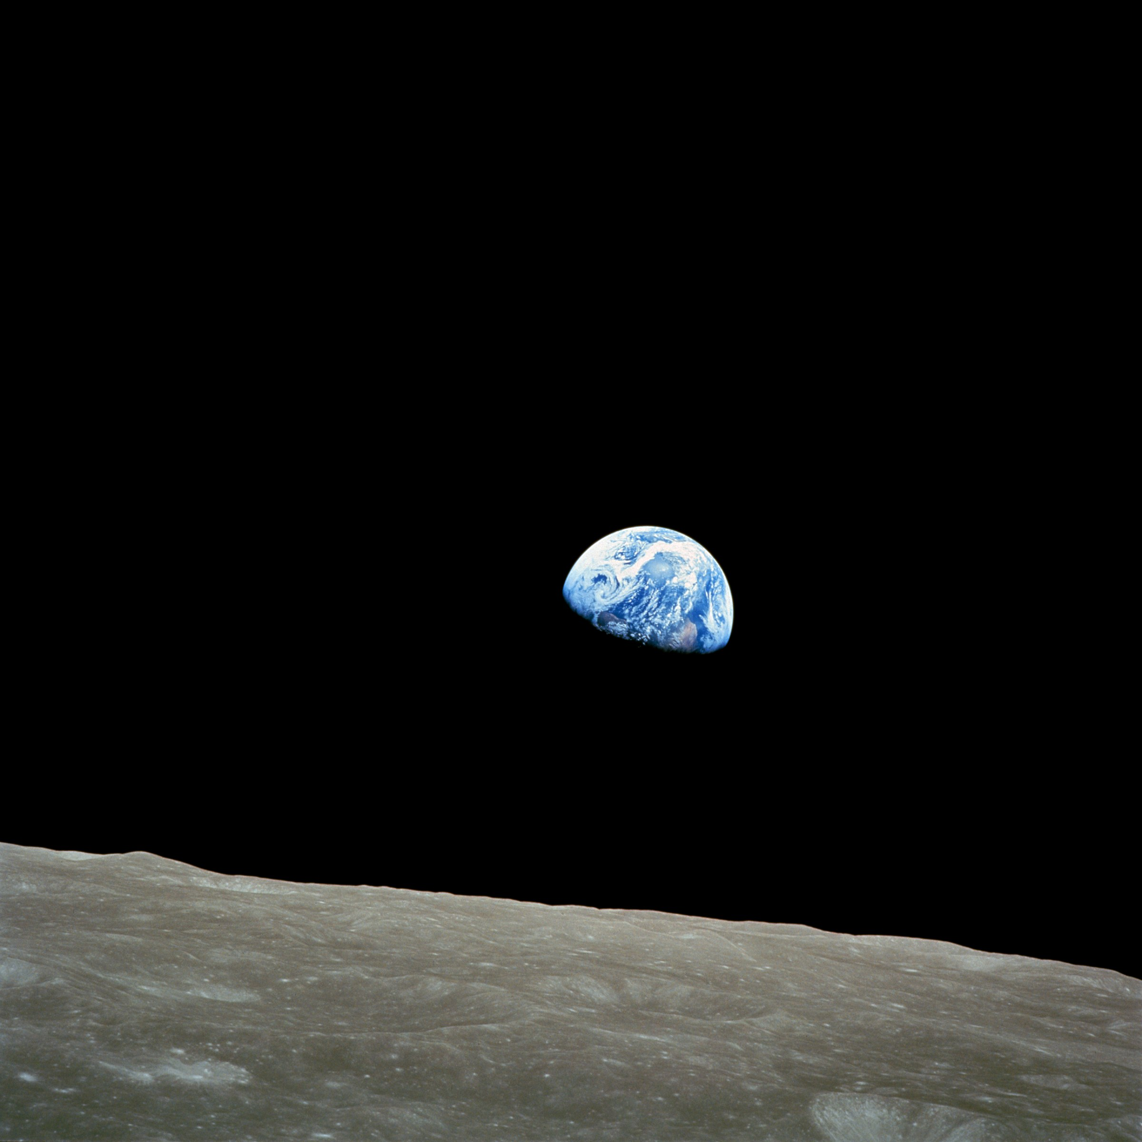
Apollo 8 - “Earthrise”

Slide 9
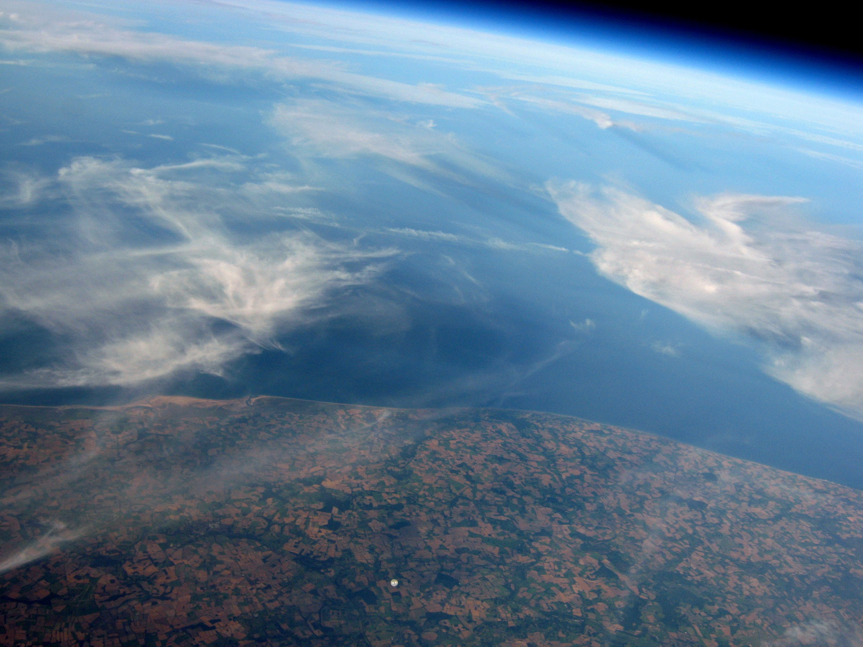

Slide 10
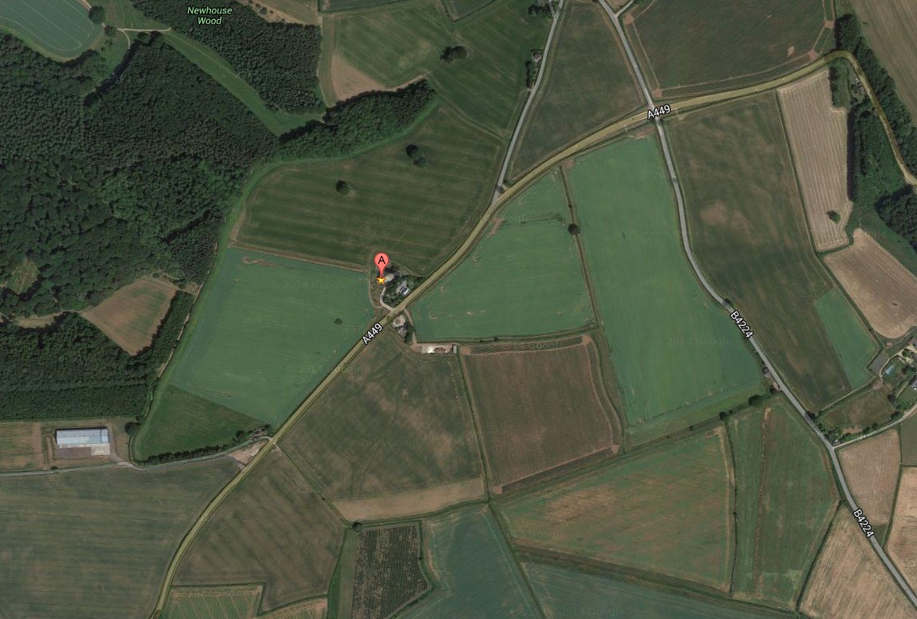
Space Exploration
Meteorology
Dendrology
Aerology
Aerodynamics
Photography
Radio
Software
Physics
Electronics

Slide 11
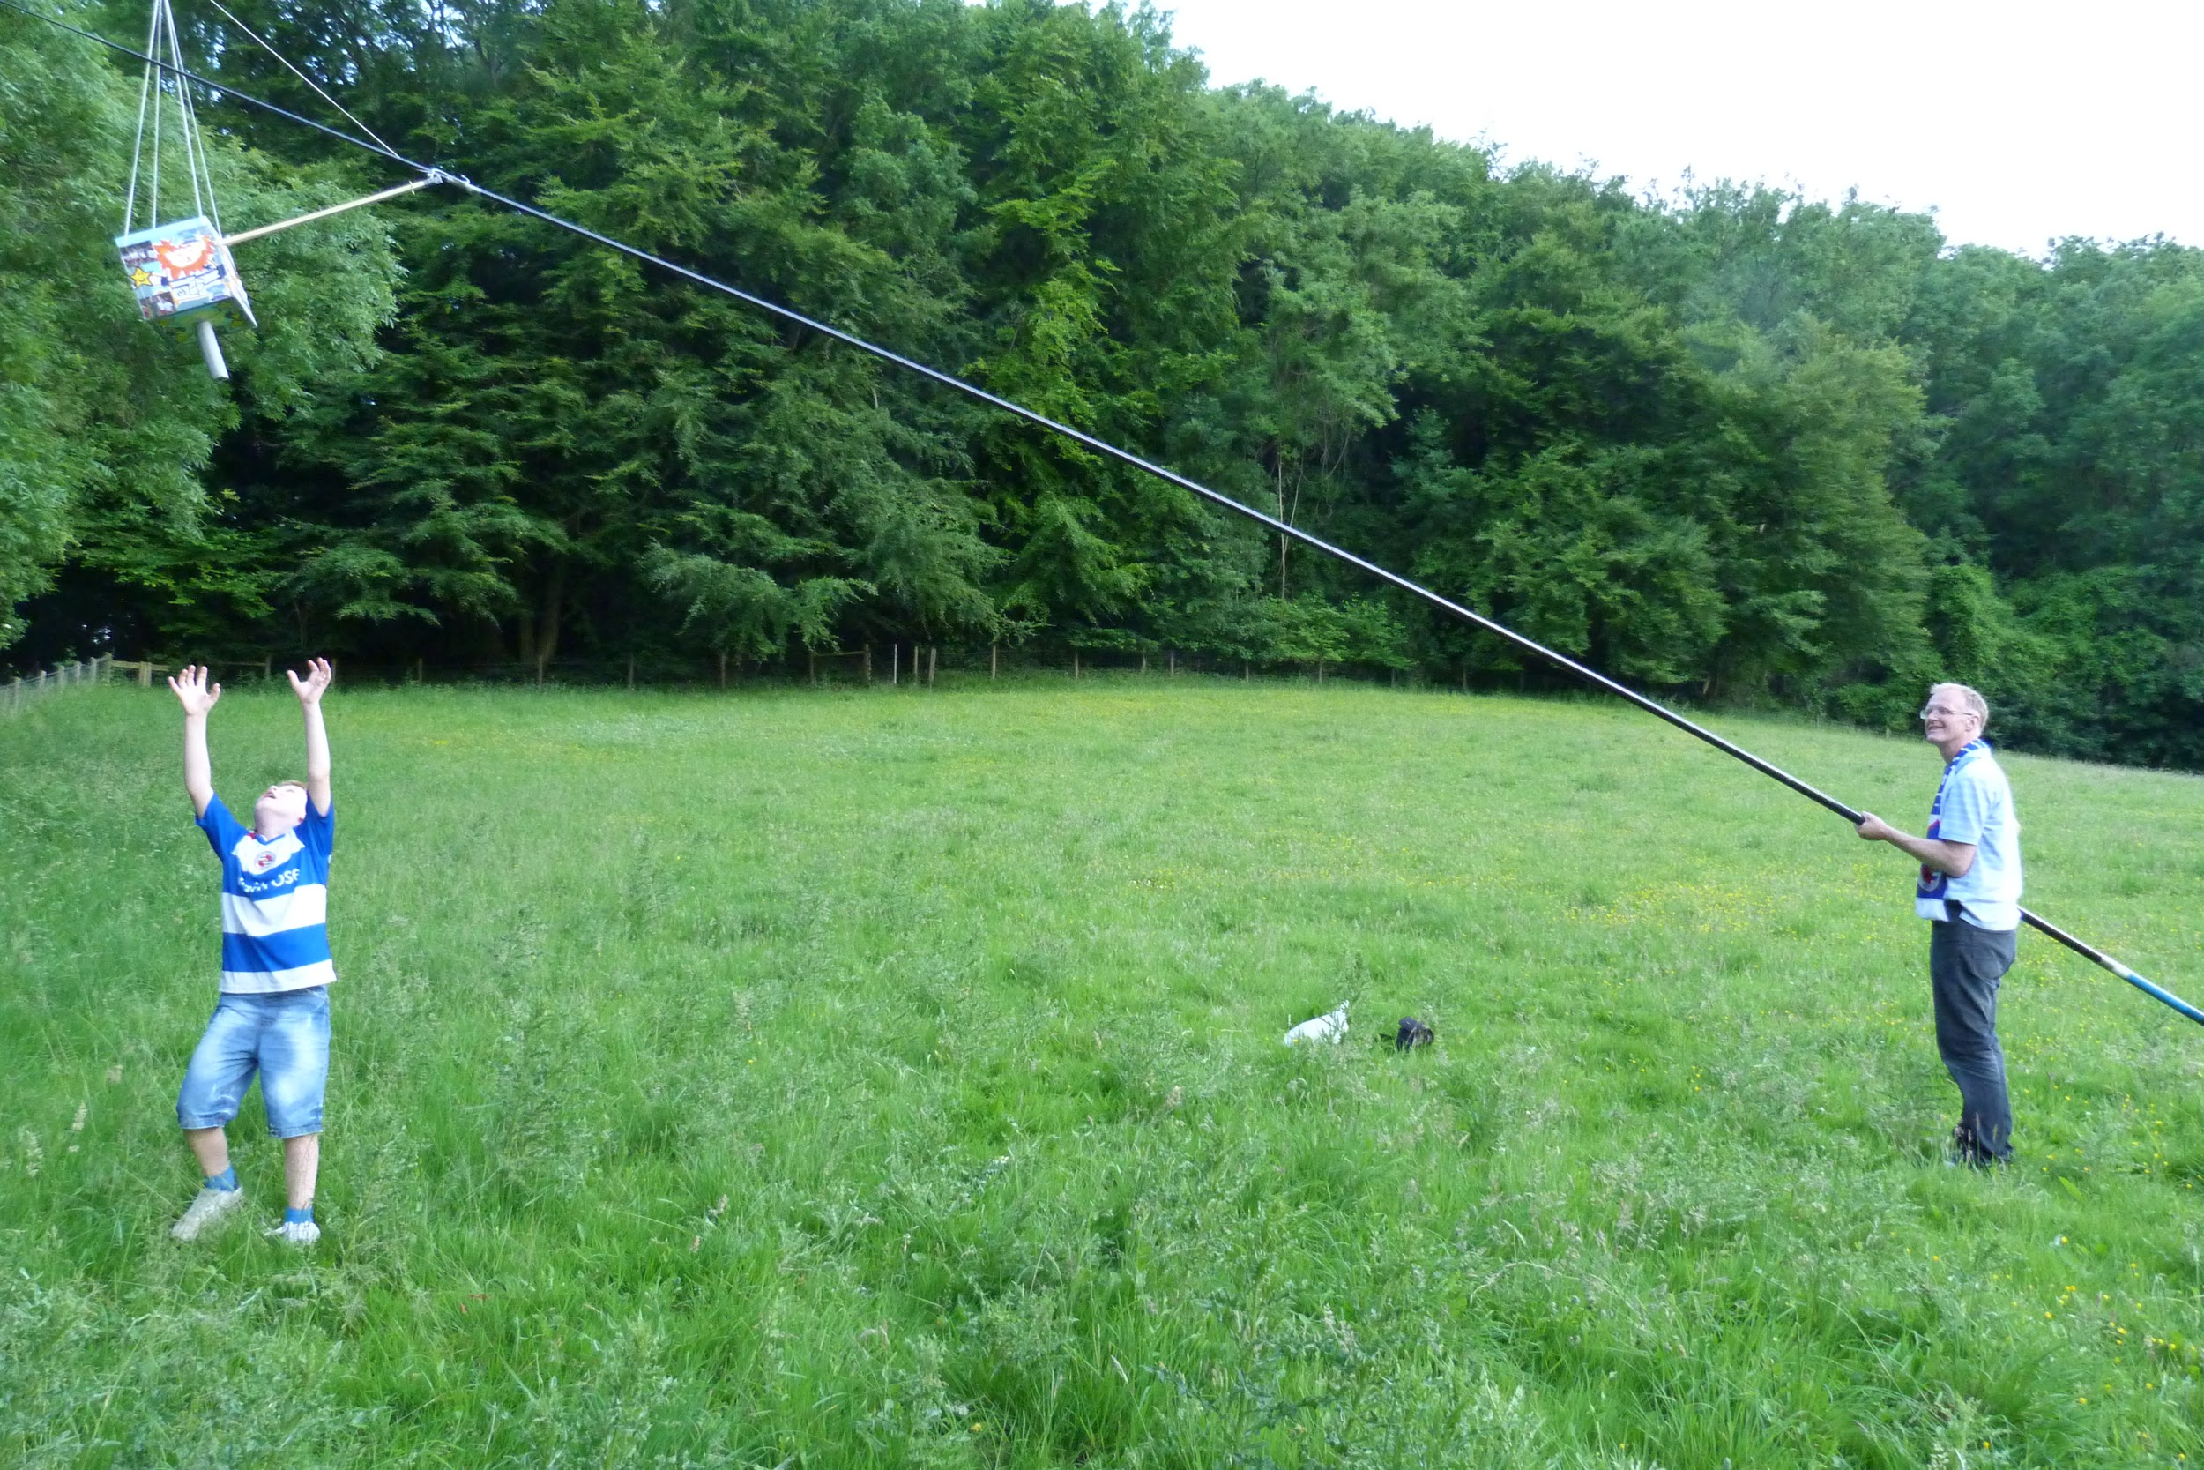
Enthuse children ….

Slide 12
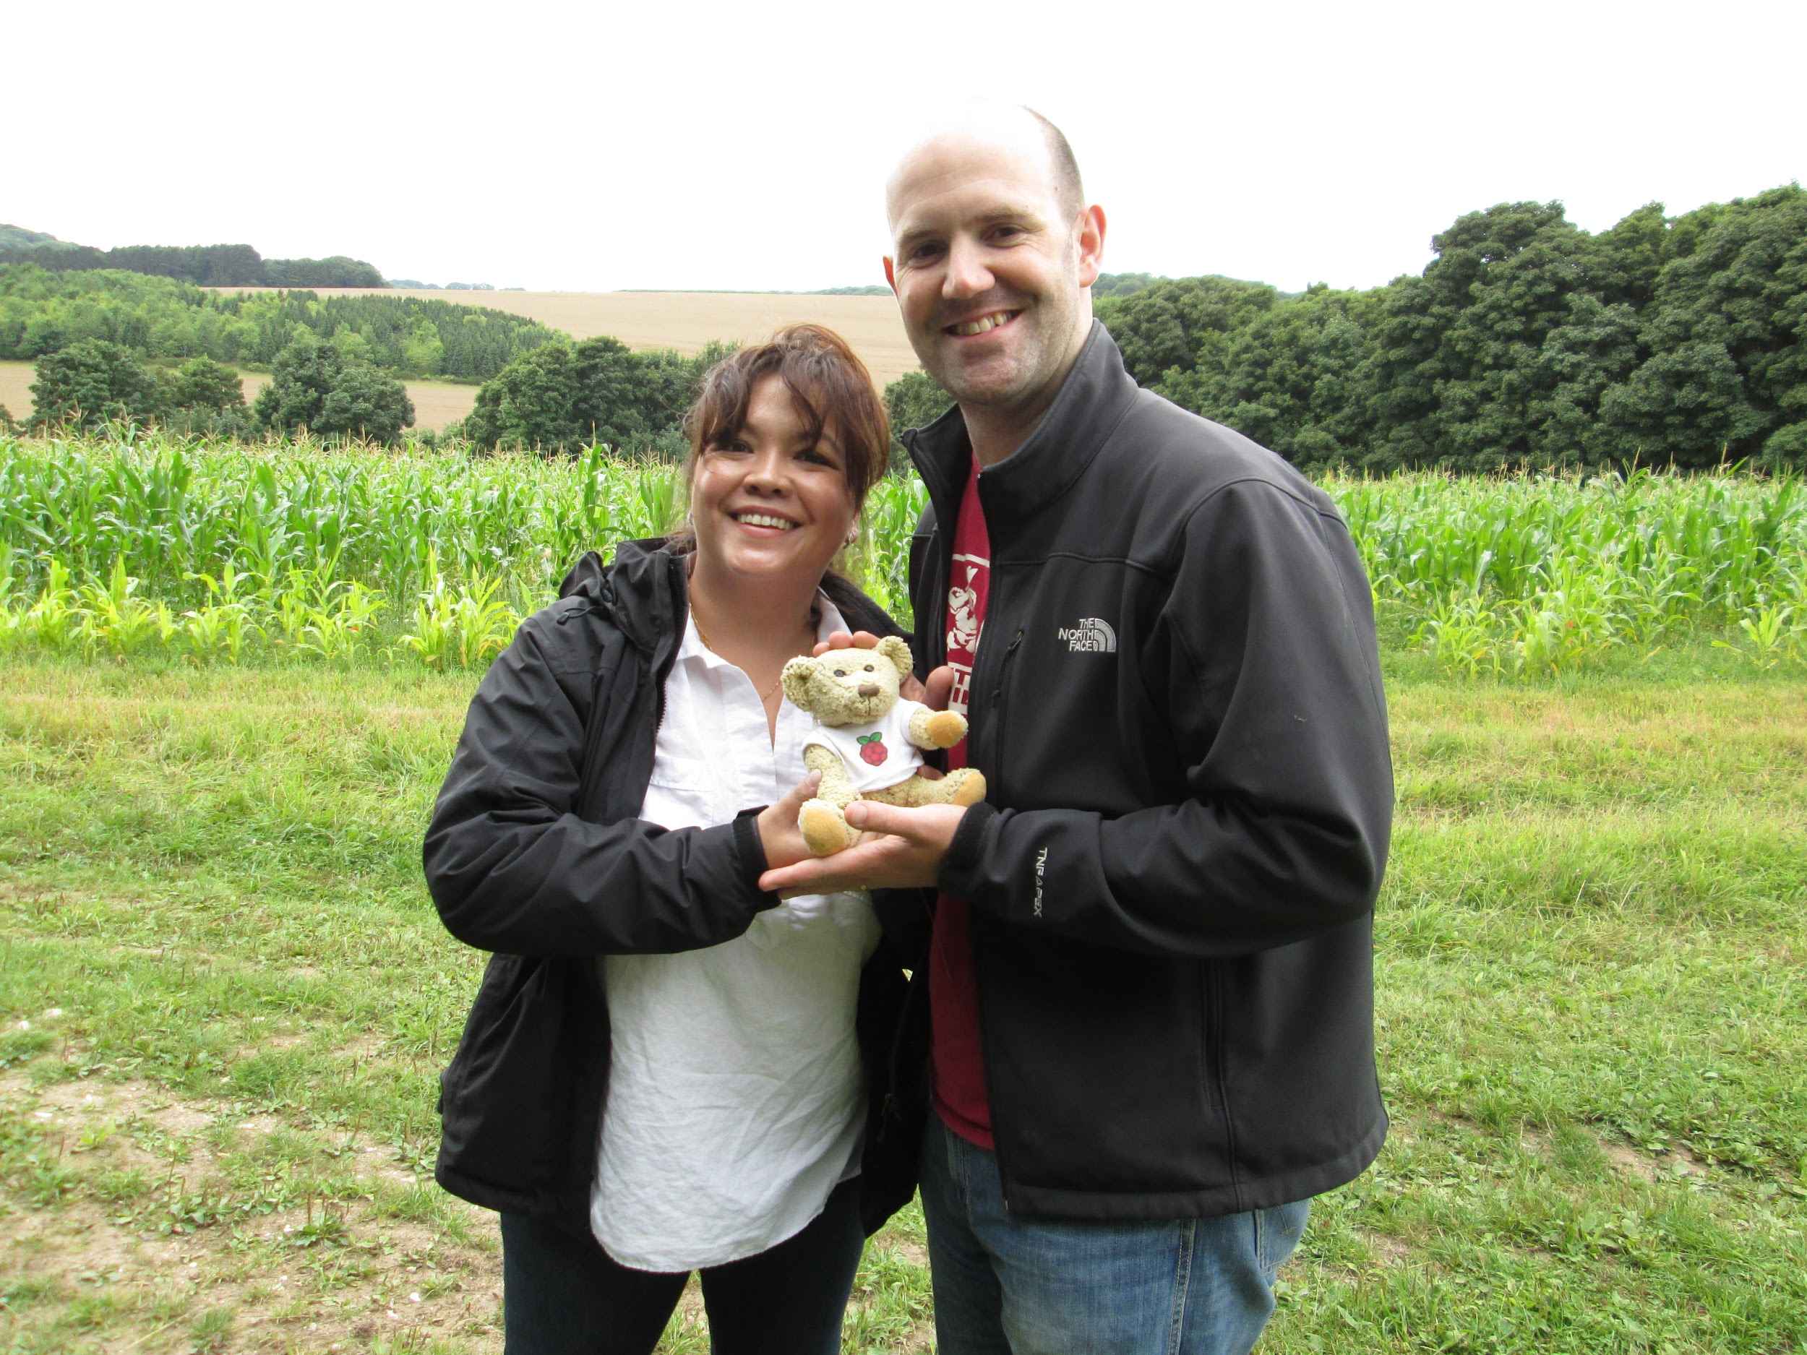
... of all ages

Slide 13
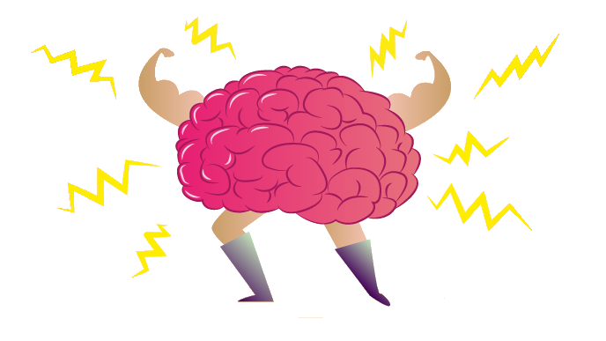
Over to you
What is your role with young people - teacher / scout leader etc?
Where are you based?
Why Skycademy?
What plans do you have beyond Skycademy?

